Slide 1
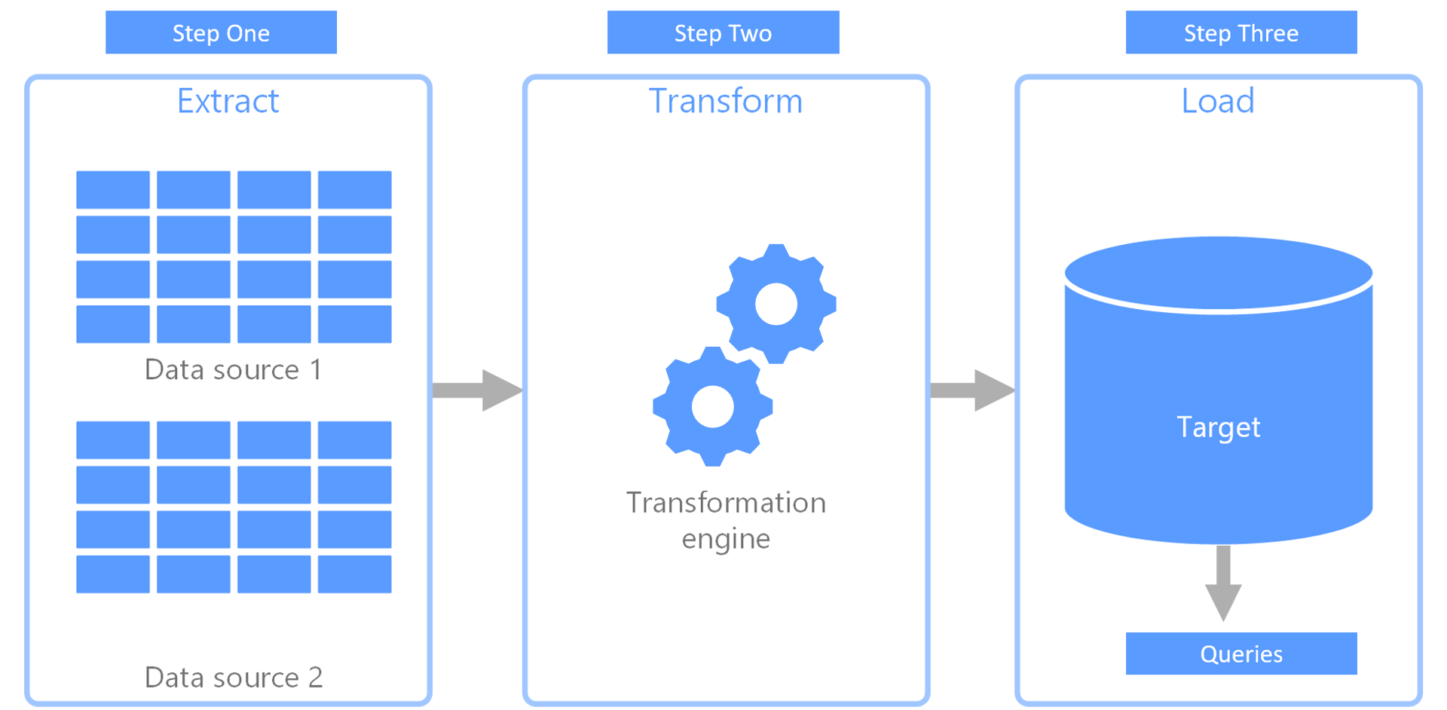
An insight into Covid-19 deaths and vaccination uptake across London

